Slide 1
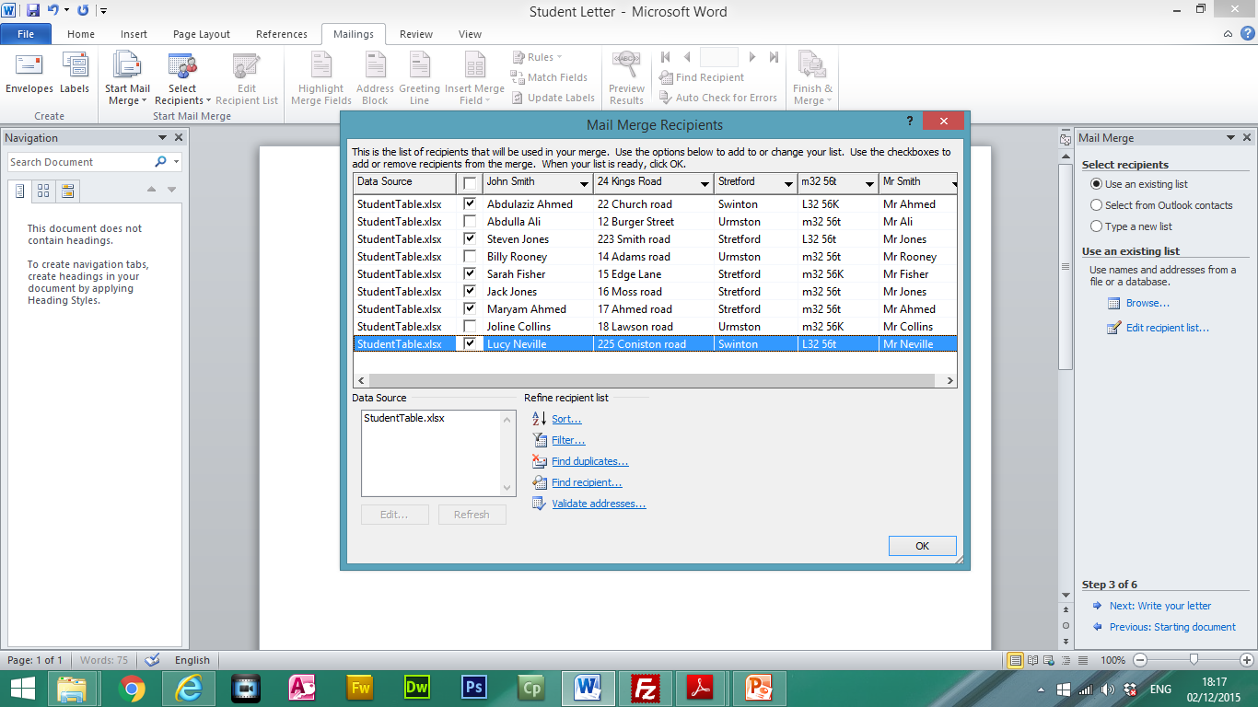
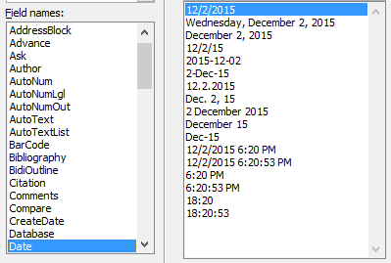
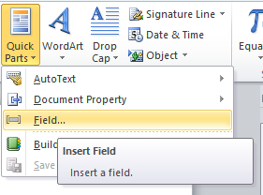
Prepare a mail merge letter using the file Studentletter.doc as your Master and the Student Table.xlsx as the source data.
Only merge the letter to students from Stretford and Swinton
Insert the relevant address fields
Insert a date field
Add your name at the bottom at the letter
Recipients can be unticked to not to be included in the mail merge.
Only pupils from Stretford and Swinton have been selected for this mail merge.

Slide 2
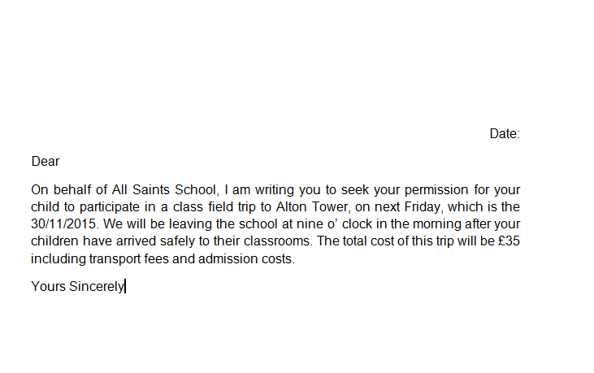
Insert the relevant mail merged fields from the source data.
Student’s Address
Parents Name
Todays Date
Your Name

Slide 3
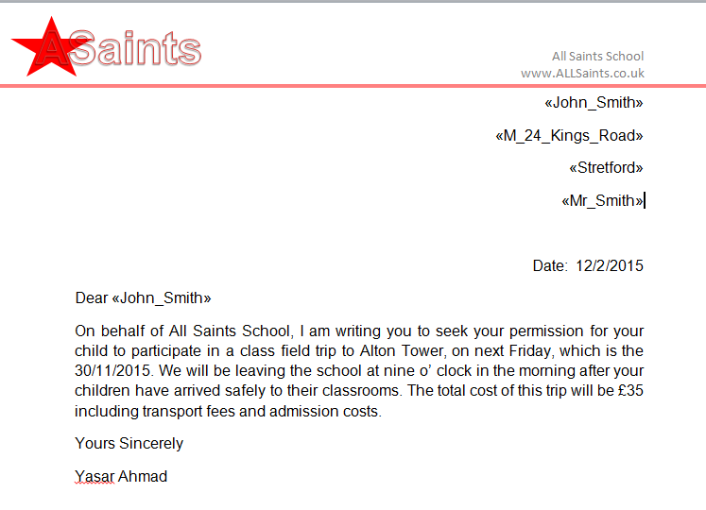
Add a minimum of three features to the mail merge master document to suit a professional letter:
Features could include:
Logo
Company Name
Contact Details/Email/Fax
Web Address
Address
Shapes
Lines
Master Document

